Slide 1
Drone Detection for Zero Eyes
By Alec Mills

Slide 2
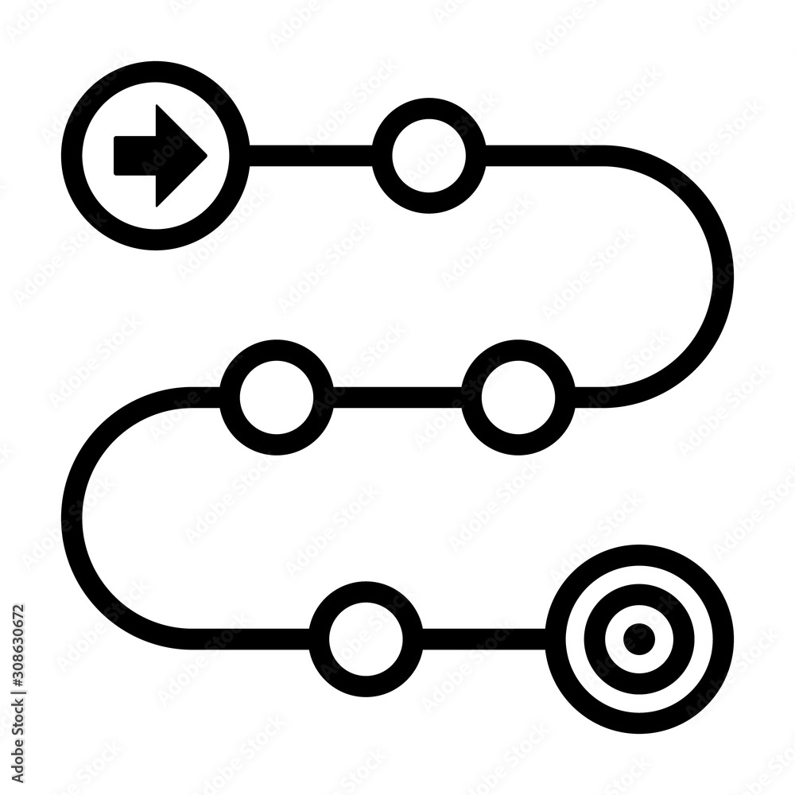
Outline
Business Problem
Data Generation
Network
Results
Summary
Questions

Slide 3
Business Problem
A neural network that will be able to detect a drone class on top of a background class.

Slide 4
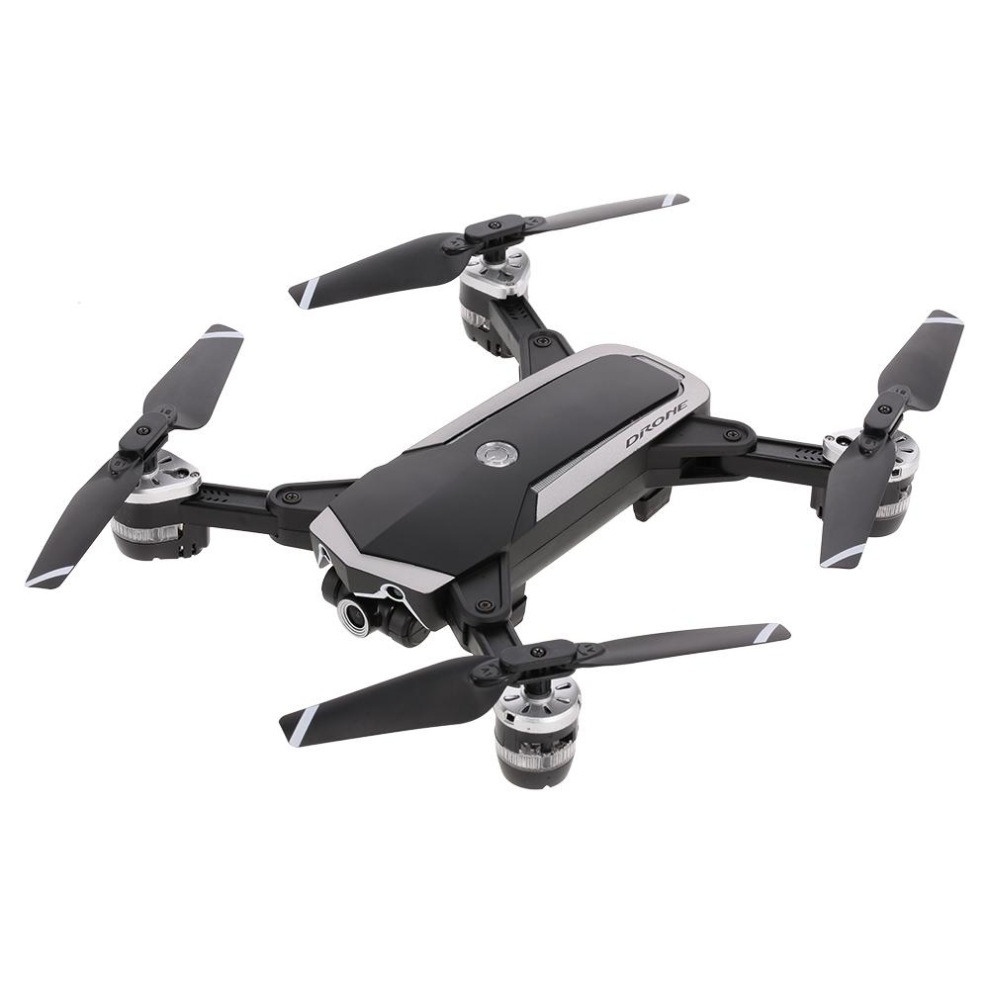
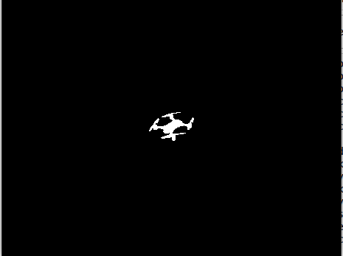

Generation Steps
Drone
Mask
Background

Slide 5
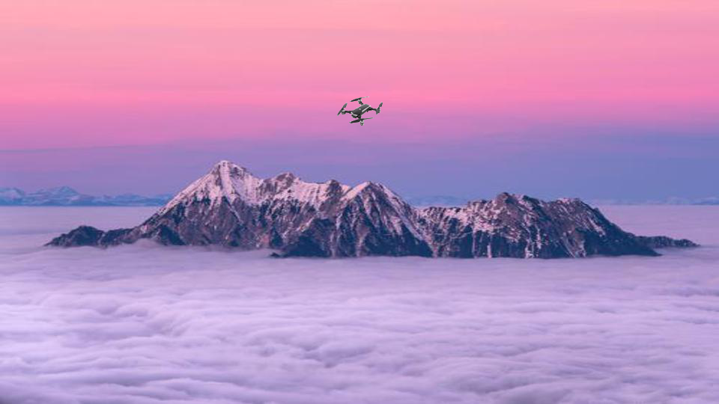
Data- Overview
Data Breakdown
20 Drone Images
880 Background Images
90,000 generated images
~ 90,000 Labels

Slide 6
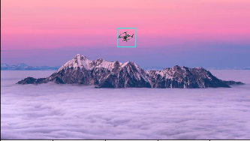

Slide 7
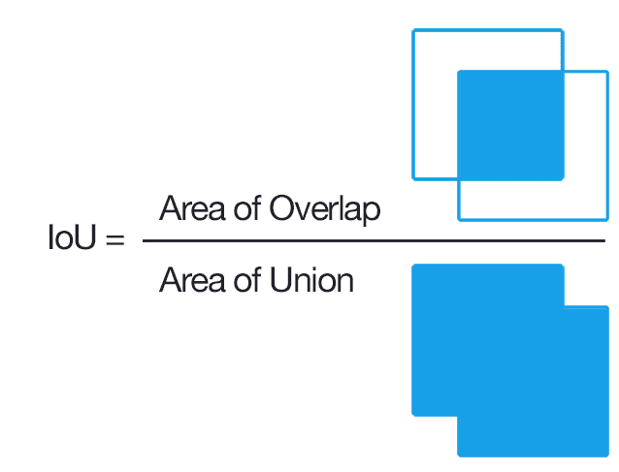
Yolo v5 Neural Network
IOU Score
Accuracy & Recall scores

Slide 8
Results
IOU Score: 1
Accuracy Score: 100%
Recall Score: 100%

Slide 9
Summary / Next Steps
The problem
Data Generation
Drone Detection
Next Steps
To Generate all the images, Created mask for drone images.
Randomly placed drones on background image.
~90,000 images
The detection was able to classify and locate with 100% accuracy.
Has an average IOU score of 1.
Handle Over Fitting
Create a Stream Lit to host the model.

Slide 10




Questions?
Alec Mills

